Slide 1


ANZ –Virtual Internship
Task 1
Exploratory Data Analysis
- Abhijit Biswas

Slide 2
Introduction
I had dataset from ANZ Bank which contained transactions of 100 customers. I was required to build a linear regression model and a decision tree model.
In order to do so I calculated the following:
annual salary, annual balance, annual spending

Slide 3
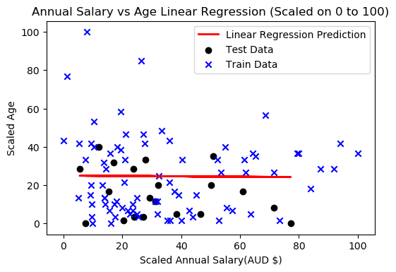
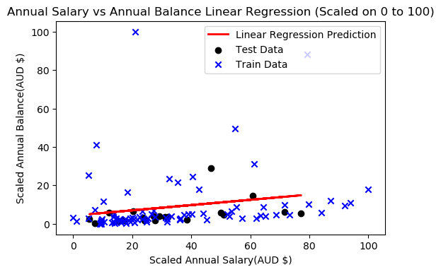
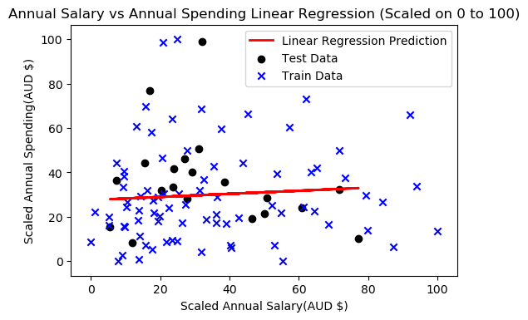
Linear Regression Model
The following graphs shows the distribution of the data and also show that the variables do not correlate with each other, so building a linear regression model will not give good results. However, we can perform classification by using the decision tree classifier.
Mean Absolute Error : 13.39
Mean Squared Error : 231.82
Root Mean Squared Error : 15.23 Correlation Coefficient r : -0.04
Mean Absolute Error : 13.39
Mean Squared Error : 231.82
Root Mean Squared Error : 15.23 Correlation Coefficient r : -0.04
Mean Absolute Error : 13.39
Mean Squared Error : 231.82
Root Mean Squared Error : 15.23 Correlation Coefficient r : -0.04

Slide 4
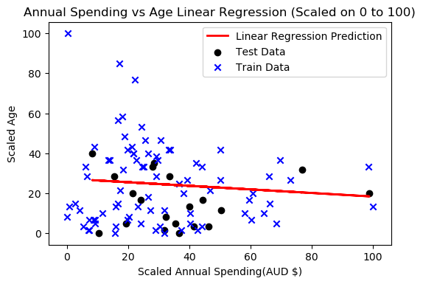
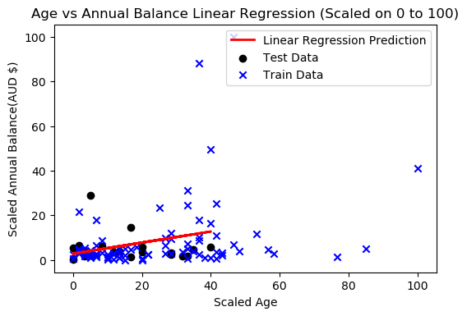
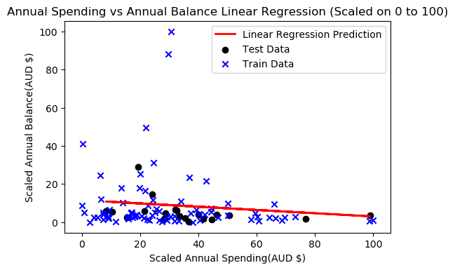
Linear Regression Model
Mean Absolute Error : 13.14
Mean Squared Error : 227.14
Root Mean Squared Error : 15.07
Correlation Coefficient r : -0.1
Mean Absolute Error : 5.4
Mean Squared Error : 56.24
Root Mean Squared Error : 7.5
Correlation Coefficient r : 0.29
Mean Absolute Error : 5.5
Mean Squared Error : 43.2
Root Mean Squared Error : 6.57
Correlation Coefficient r : -0.13

Slide 5
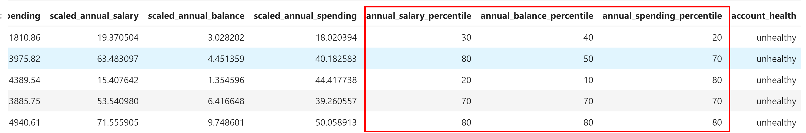
1. In order to build a decision tree model, I wanted to be able to rank the data based on the data and as a result I decided to incorporate percentiles for each of the features.
2. The decision tree classifier is a supervised learning algorithm so due to that I needed to classify the training data as well. This was done by using the percentiles and dividing them into high, medium and low classes which are then in combination labelled as either being a healthy or unhealthy account.
3. The accuracy that the decision tree model has achieved is of 90%.
Decision
Tree
Model

Slide 6
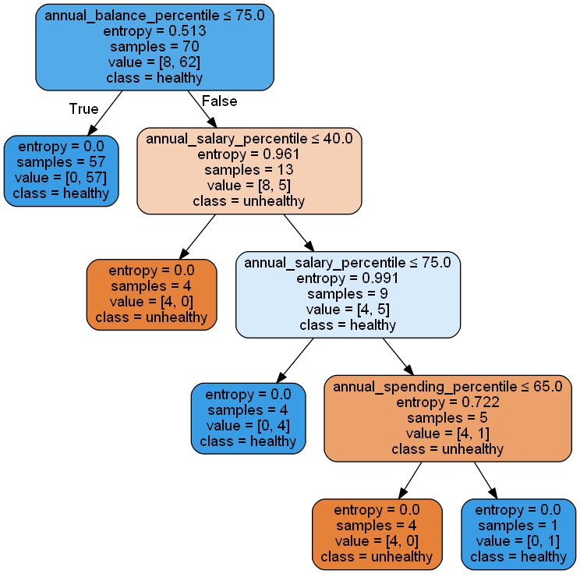
Decision
Tree
Model

Slide 7
Thank You

